Slide 1

MATH30
Probability and Statistics

Slide 2
Frequency distribution and Graphical Methods
A frequency distribution is one of the most common ways to describe a single variable, depending on the particular variable, all of the data values may be represented or you may group the values into categories. Frequency distributions can be depicted in two ways, as table or as a graph.

Slide 3
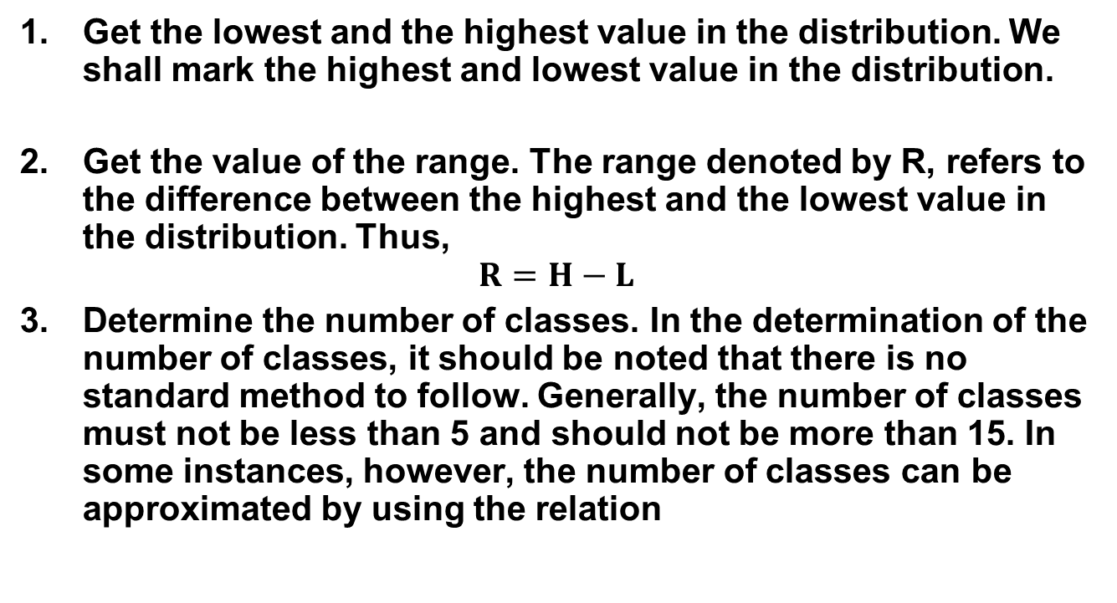
Steps in Constructing a Frequency Distribution
Get the lowest and the highest value in the distribution. We shall mark the highest and lowest value in the distribution.
Get the value of the range. The range denoted by R, refers to the difference between the highest and the lowest value in the distribution. Thus,
$$R=H−L$$
Determine the number of classes. In the determination of the number of classes, it should be noted that there is no standard method to follow. Generally, the number of classes must not be less than 5 and should not be more than 15. In some instances, however, the number of classes can be approximated by using the relation

Slide 4
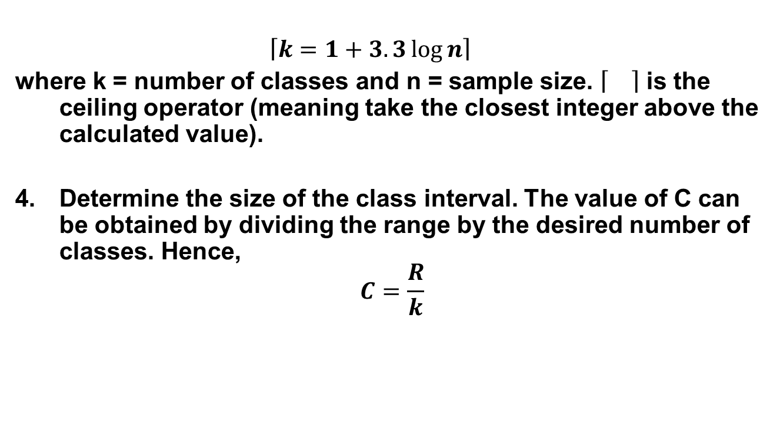
Steps in Constructing a Frequency Distribution
$$\left\lceil k=1+3.3\log{n}\right\rceil$$
where k = number of classes and n = sample size. is the ceiling operator (meaning take the closest integer above the calculated value).
Determine the size of the class interval. The value of C can be obtained by dividing the range by the desired number of classes. Hence,
$$C=\frac{R}{k}$$

Slide 5
Steps in Constructing a Frequency Distribution
Construct the classes. In constructing the classes, we first determine the lower limit of the distribution. The value of this lower limit can be chosen arbitrarily as long as the lowest value shall be on the first interval and the highest value to the last interval.
Determine the frequency of each class. The determination of the number of frequencies is done by counting the number of items that shall fall in each interval.

Slide 6
Examples
Using the steps discussed, construct the frequency distribution of the following results of a test in statistics of 50 students given below.
88 | 62 | 63 | 88 | 65
85 | 83 | 76 | 72 | 63
60 | 46 | 85 | 71 | 67
75 | 78 | 87 | 70 | 43
63 | 90 | 63 | 60 | 73
55 | 62 | 62 | 83 | 79
78 | 43 | 51 | 56 | 80
90 | 47 | 48 | 54 | 77
86 | 55 | 76 | 52 | 76
43 | 52 | 72 | 43 | 60

Slide 7
Examples
2. The following are the scores of 40 students in a Math quiz. Prepare a frequency distribution for these scores using a class size of 10.
22 | 31 | 55 | 76 | 48 | 49 | 50 | 85 | 17 | 38
92 | 62 | 94 | 88 | 72 | 65 | 63 | 25 | 88 | 88
86 | 75 | 37 | 41 | 76 | 64 | 66 | 58 | 66 | 76
52 | 40 | 42 | 76 | 29 | 72 | 59 | 42 | 54 | 62

Slide 8
Relative Frequency Distribution
The relative frequency distribution denoted by %rf shows the proportion in percent the frequency of each class to the total frequency. This can be obtained by dividing the class frequency by the total frequency, and multiplying the answer by 100.

Slide 9
Cumulative Frequency Distribution
The cumulative frequency distribution can be derived from the frequency distribution and can be also obtained by simply adding the class frequencies. This type of distribution tries to determine the partial sums from the data classified in terms of classes.
Types:
Less than cumulative frequency (<cf) refers to the distribution whose frequencies are less than or below the upper class boundary they correspond to.
Greater than cumulative frequency (>cf) refers to the distribution whose frequencies are greater than or above the lower class boundary the correspond to.

Slide 10
Frequency Distribution Table
LL – Lower Limit
UL – Upper limit
Class Interval | Frequency (f) | %rf | <cf | >cf
LL1 – UL1
LL2 – UL2
.
.
.
LLn – ULn

